Slide 1

RMSP

Slide 2

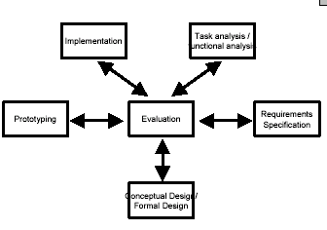
RMSP

Slide 3
RMSP
Users lack the ability to imagine the ramifications of design decisions
Users are often unable to comment on technical design documents
Providing complete, consistent and readable representation of user interaction virtually impossible

Slide 4

RMSP
May be thrown out or evolve
May serve multiple purposes
Must be built quickly and cheaply

Slide 5

RMSP
Test technical feasibility
Clarify vague requirements
Get usability feedback
Compare design approaches
Generate interest or “buy-in”
Avoid added expense

Slide 6

RMSP
Technical aspects
Workflow, task design
Screen layouts and information display
Graphic design, look-and-feel
Content and nomenclature
  e.g. taxonomy of objects/widgets, etc.
Controversial or critical areas
  e.g. security issues

Slide 7

RMSP
Fidelity
  Low Fidelity
  High Fidelity
Structural
  Horizontal
  Vertical

Slide 8

RMSP
Fidelity measures how similar the prototype is to the finished interface
Low fidelity: cheaper materials, omit details
High fidelity: look more like finished product

Slide 9

RMSP
Breadth: % of features covered by the prototype
  Low-fi in breadth: Only enough features for a certain task
Depth: degree of functionality of the prototype
  Low-fi in depth: limited choices, canned responses, no error handling

Slide 10

RMSP
Look: appearance, graphic design
  Sketchy, hand-drawn
Feel: input method
  Physical methods by which the user interacts with the prototype
    E.g.: Pointing and writing feels very different from mouse and keyboard

Slide 11

RMSP
Low-Fi Prototypes
  Textual Scenarios
  Mockups / Design Sketches
  Storyboards (limited)

Slide 12

RMSP
Paper-based prototypes
  a paper mock-up of the interface look, feel, functionality
  “quick and cheap” to prepare and modify
Purpose
  brainstorm competing representations
  elicit user reactions
  elicit user modifications / suggestions

Slide 13

RMSP
Sketches
  drawing of the outward appearance of the intended system
  crudity means people concentrate on high level concepts
  but hard to envision a dialog’s progression
Computer Telephone
Last Name:
First Name:
Phone:
Place Call
Help

Slide 14

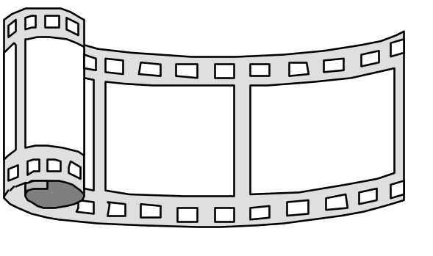
RMSP
Storyboarding
  a series of key frames
    originally from film; used to get the idea of a scene
    Paper screens of the interface at particular points in the interaction
  users can evaluate quickly the direction the interface is heading

Slide 15

RMSP
Computer Telephone
Help Screen
Computer Telephone
Last Name:
You can enter either the
Help->
person's name or their
Call by
Last Name: McGrenere
Establishing
First Name:
number. Then hit the
name->
First Name:
connection->
Phone:
place button to call them
Phone:
Place Call
Help
Return
Place Call
Help
Computer Telephone
Computer Telephone
Dialling....
Call
Call
Last Name: Greenberg
connected...
Connected
First Name:
Last Name: Greenberg
completed...
Phone:
Cancel
First Name:
Phone:
Hang up
Place Call
Help
Place Call
Help

Slide 16
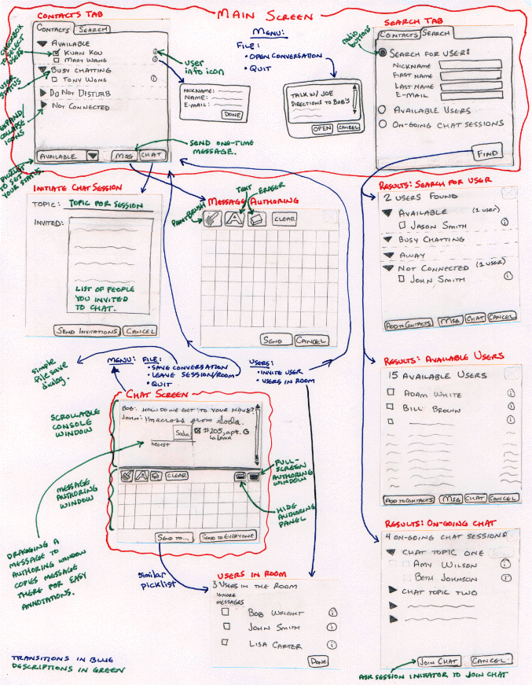
RMSP
Ink Chat

Slide 17


RMSP
Tutorials and manuals
  write them in advance of the system
  what are they?
    tutorial for step by step description of an interaction
      an interface “walk-through” with directions
    manual for reference of key concepts
      in-depth technical description
  if highly visual, then storyboard is set within textual explanations
  does this work?
    people often read manuals of competing products to check:
      interface
      functionality
      match to task

Slide 18
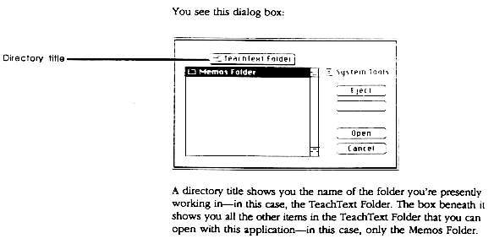
RMSP

Slide 19
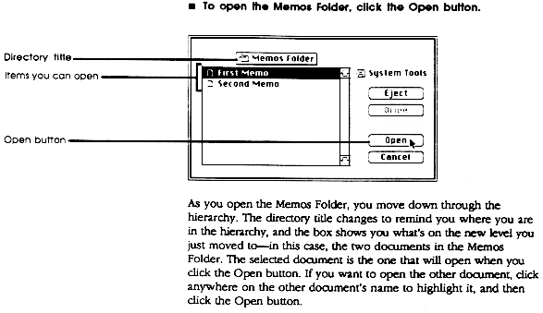
RMSP

Slide 20

RMSP
Make it BIG
Make it monochromatic
Replace tricky visual feedback with audible descriptions
Keep pieces organized

Slide 21

RMSP
Roles for the design team
  ‘Computer’
    manipulates prototype
    Doesn’t give any feedback that the computer wouldn’t
  Facilitator
    Explains purpose and process of the user study
    Obtains the user’s informed consent
    Presents the tasks one by one
    Encourages user to think aloud while the user is working on a task
  Observers
    Just for watching, not helping the user
    Takes notes

Slide 22

RMSP
Conceptual model
  Do users understand it?
Functionality
  Does it do what is needed?
Navigation and task flow
  Can users find their way around?
  Are task preconditions met?
Terminology
  Do users understand labels?
Screen contents
  What needs to go on the screen

Slide 23

RMSP
Look: color, font, white space etc.
Feel: interaction with paper prototype may be different than with final UI
Response time (backend simulated by ‘human computer’)
Are small changes noticed?
  Even the tiniest change to a paper prototype is clearly visible to the user
Exploration versus deliberation
  Users are more deliberate with a paper prototype; they don’t explore as much

Slide 24

RMSP
High-Fidelity Prototypes
  Interaction with Computer or with something that appears to be a real device….(‘machine interaction’)

Slide 25

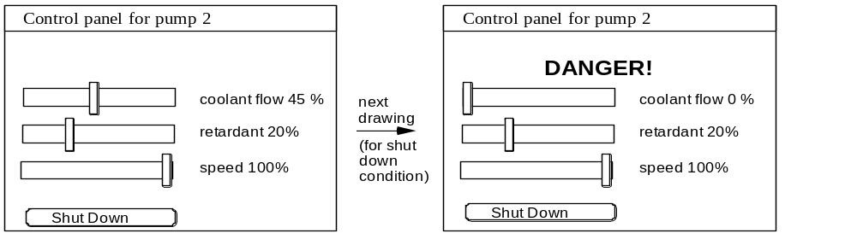
RMSP
Painting/drawing packages- that create screens with story line
  draw each storyboard scene on computer
    neater/easier (?) to change on the fly than paper
  a very thin horizontal prototype
  does not capture the interaction “feel”

Slide 26
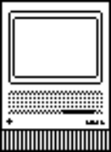
RMSP
Scripted simulations and slide shows
  encode the storyboard on the computer
    created with media tools
    scene transition activated by simple user inputs
    a simple horizontal and vertical prototype
  user given a very tight script/task to follow
    appears to behave as a real system
    but script deviations blows the simulation
Control panel for pump 2
Control panel for pump 2
DANGER!
coolant flow 45 %
next
coolant flow 0 %
retardant 20%
drawing
retardant 20%
(on mouse
speed 100%
press over
speed 100%
button)
Shut Down
Shut Down

Slide 27

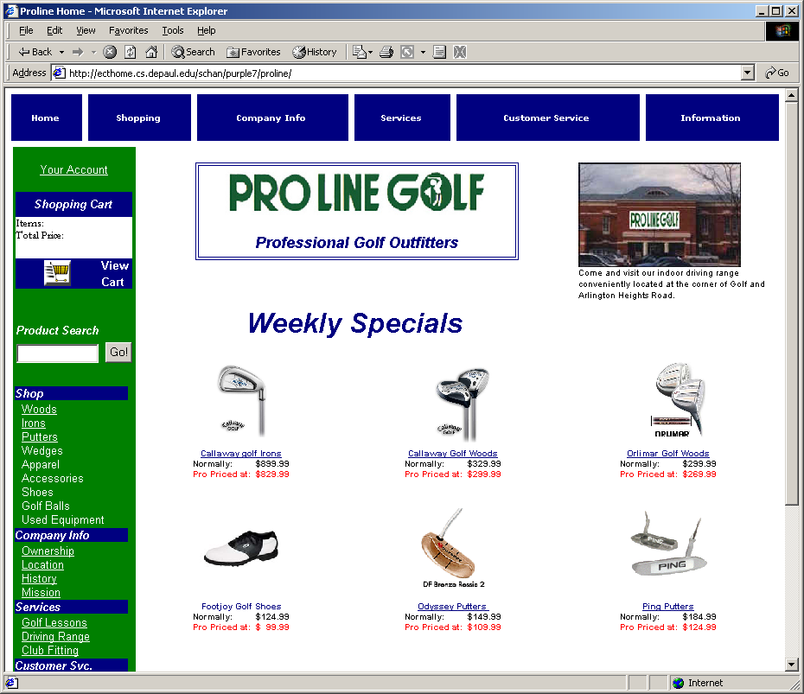
RMSP

Slide 28
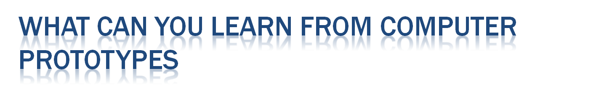
RMSP
Everything you learn from paper prototypes plus:
Screen layout
  Is it clear, overwhelming, distracted, complicated?
  Can users find important elements?
Colors, fonts, icons, other elements
  Well-chosen?
Interactive feedback
  Do users notice and respond to status bar messages, cursor changes, other feedback
Fitt’s law issues
  Controls large enough? Too close together? Etc.

Slide 29

RMSP
Storyboard
Sequence (graph) of painted screenshots connected by hyperlinks (“hotspots”)
Form builder: a tool for drawing real, working interfaces by dragging widgets from a palette and positioning them on a window
Wizard of Oz: hybrid between a computer prototype and a paper prototype

Slide 30

RMSP
HTML: each screen is an image map
Flash:
  Tool for constructing multimedia interfaces;
  Particularly useful for prototyping interfaces with rich animated feedback
PowerPoint: images + links +animation

Slide 31

RMSP
Pros
  You can draw anything
Cons: storyboarding is static
  All you can do is click, not enter text
  Widgets (scrollbars, list boxes, buttons) are static pictures
  Testing with users: “Hunt for the hotspot”

Slide 32

RMSP
HTML pages and forms
  Natural if you’re building a web application of your web interface
  May have low-fidelity look
Java GUI builders: Sun NetBeans, Eclipse, Visual Editor, Borland JBuilder
Other gui builders
  Visual basic, NET windows forms, Mac Interface…

Slide 33

RMSP
Pros
  Use actual working widgets, not just pictures of them
  Can hook in some backend if you need it
    But then you won’t want to throw it away
Cons
  Limits thinking to standard widgets
  Useless for rich graphical interfaces

Slide 34

RMSP
The Nokia TV guide: a dialogue system customized for TV program information to be used in the Nokia Media Terminal
Iterative computer prototyping
first iteration: prototype able to respond to isolated questions (no context used when interpreting a request)
second iteration: enriched interaction, system more ’intelligent’

Slide 35

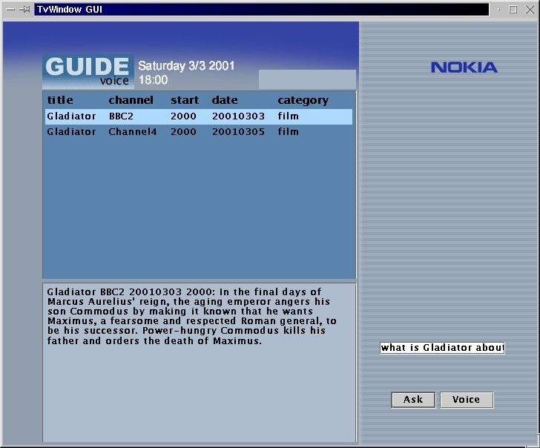
RMSP

Slide 36

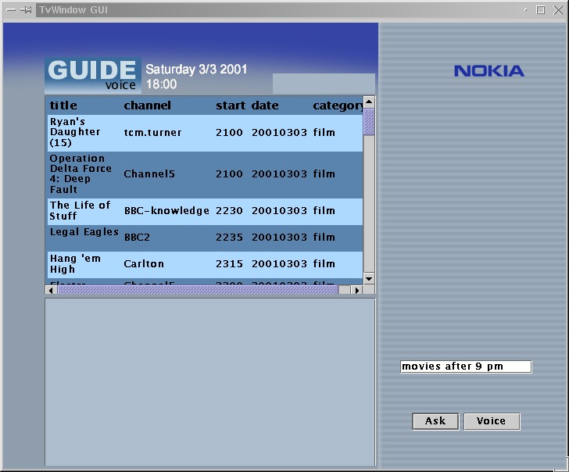
RMSP

Slide 37

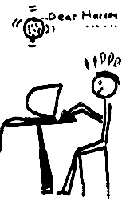
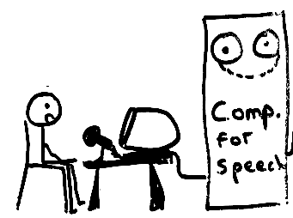
RMSP
A method of testing a system that does not exist
  the voice editor, by IBM (1984)
What the user sees
The Wizard

Slide 38

RMSP
ADVANTAGES
  Actual functionality
  Interactive
  Working navigation
  Supports interactive usability tests
  Real “look-feel”
  Living spec
  Demo tool
DISADVANTAGES
  Expense
  Time
  Too polished and expensive for effective req gathering and testing

Slide 39

RMSP
Prototyping different parts of the project
  Horizontal Prototyping
    Navigation
  Vertical Prototyping
    A task

Slide 40

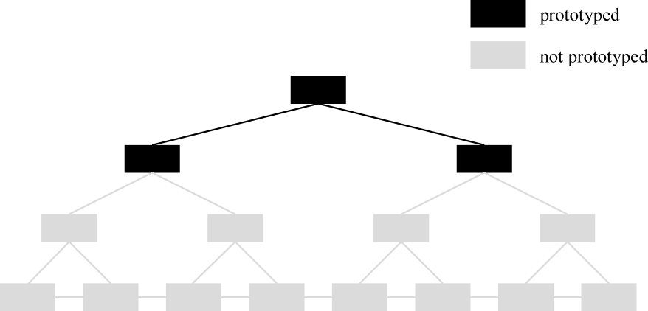
RMSP

Slide 41

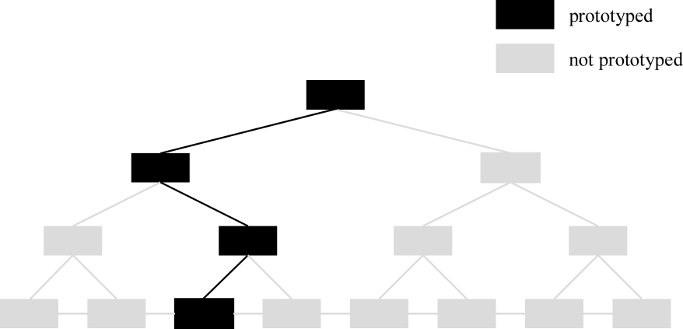
RMSP

